Slide 1

LaserPreso:
helping speakers to edit presentations with only laser pointer
FINAL PROJECT
PROJECT · PROJECT · PROJECT · PROJ
Authors: Iana Kulichenko,
Dmitry Nalbersky

Slide 2

01
Problem description
PROJECT · PROJECT · PROJECT · PROJ
During presentations, there is often a need to highlight information on a slide, urgently emphasize/underline/cross out something. Current solutions include editing the slide in PowerPoint, requiring the speaker to be at the lectern with a computer, or providing oral instructions, which may not always be clear.

Slide 3
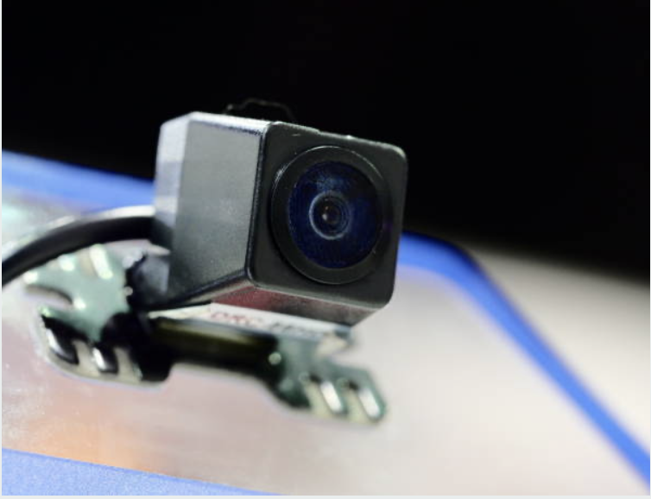
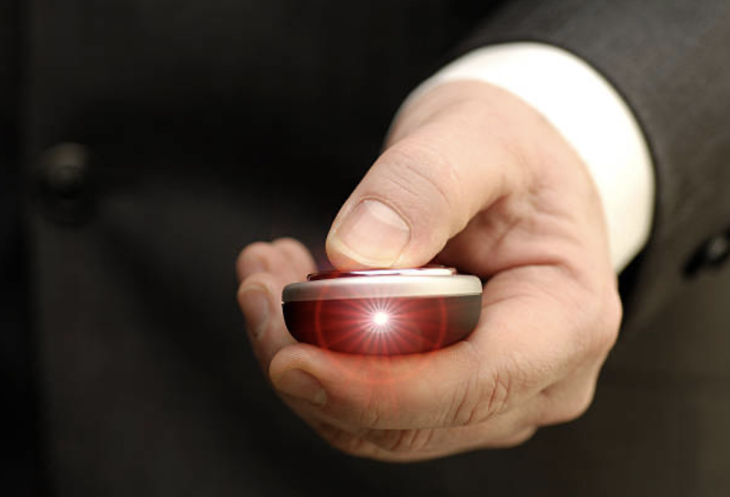
02 Our solution
PORTFOLIO · PORTFOLIO · PORTFOLIO
PROJECT · PROJECT · PROJECT · PROJ
Involves using a securely mounted camera directed at the slide, a laser pointer controlled by the speaker and computer vision algorithms. Our solution frees the speaker from being near the computer, allowing him/her to move around the room while making annotations on the presentation. We think that our solution is compatible with existing clickers. The value lies in innovation and satisfying our own interest.

Slide 4

CV Algorithm 03
01
02
03
A camera is securely mounted in the room, directed at the projection screen.
A calibration pattern with ArUco markers is displayed on the screen.
The camera captures an image of the calibration pattern.
PORTFOLIO · PORTFOLIO · PORTFOLIO
PROJECT · PROJECT · PROJECT · PROJ
04
05
06
ArUco markers in the captured image are recognized.
The laser pointer spot is detected using a color thresholding.
Homography transformation is computed based on the recognized markers.
07
08
09
The center of the spot is calculated using image moments.
A straight line is drawn between two consecutive spot centers using built-in functions.
The drawn object is recognized using a neural network and replaced with the recognized figure.

Slide 5


05 Examples of converted images

Slide 6
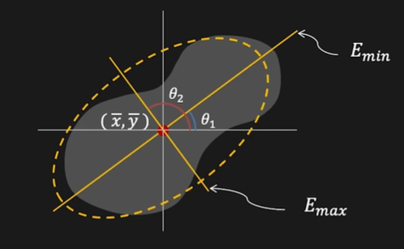

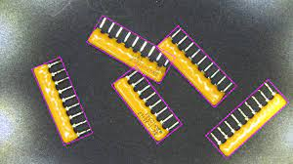
06
Comparison of methods
PROJECT · PROJECT · PROJECT · PROJ
Image moments - very subject to outliers
Minimal bounding box - that’s it!
OBB YOLO - hard to implement

Slide 7
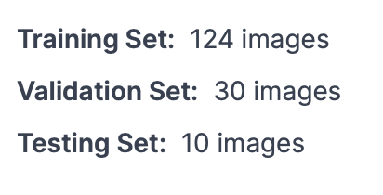

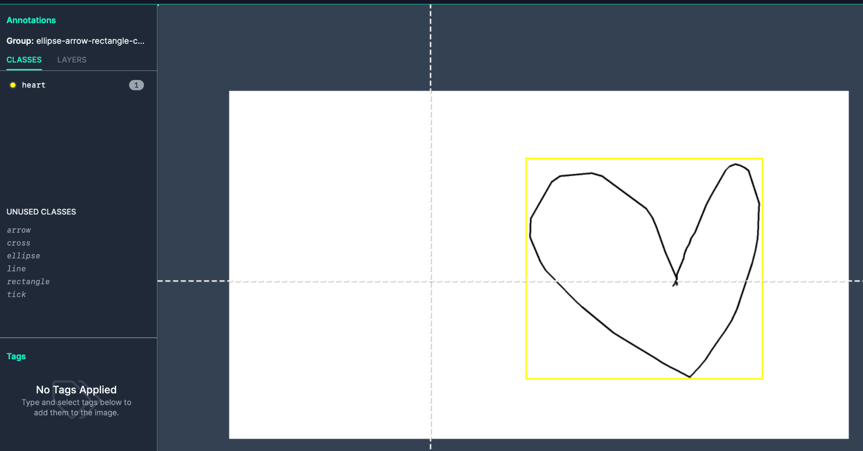
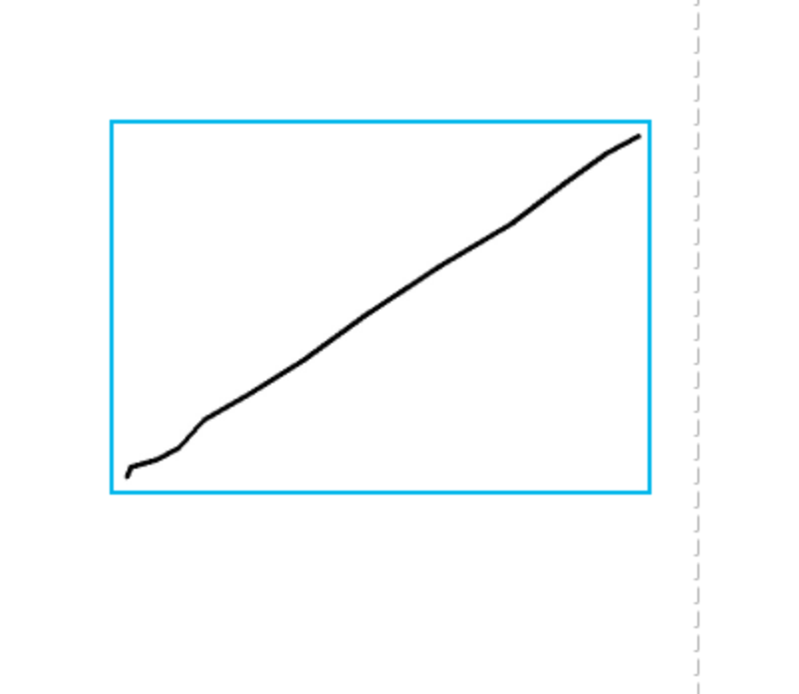
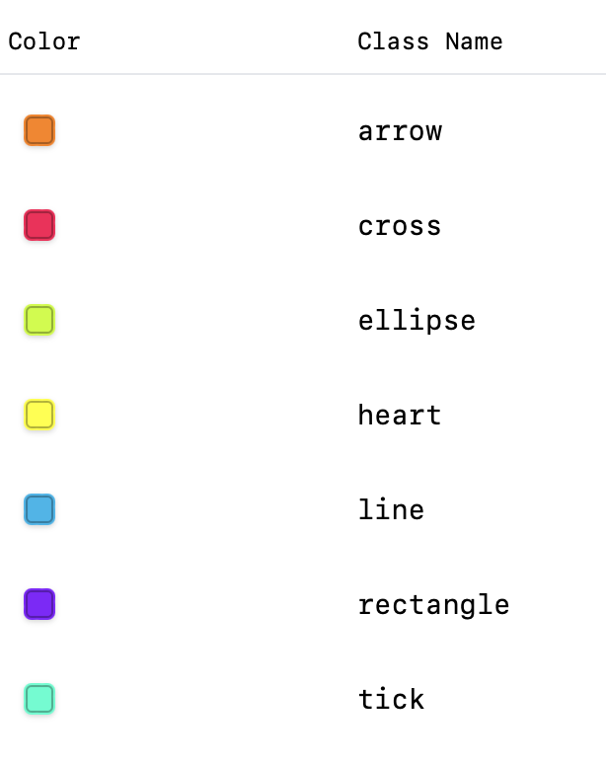
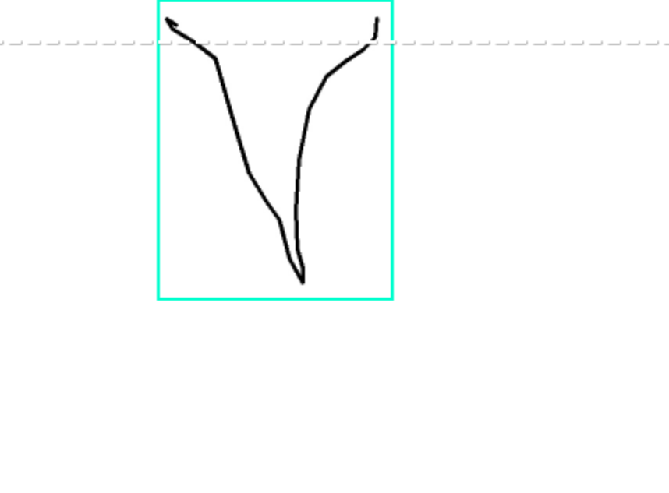
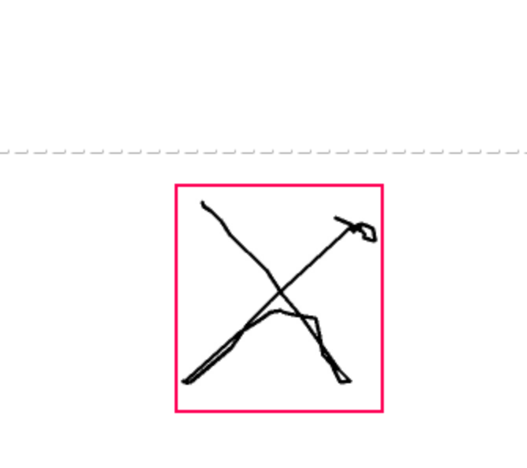
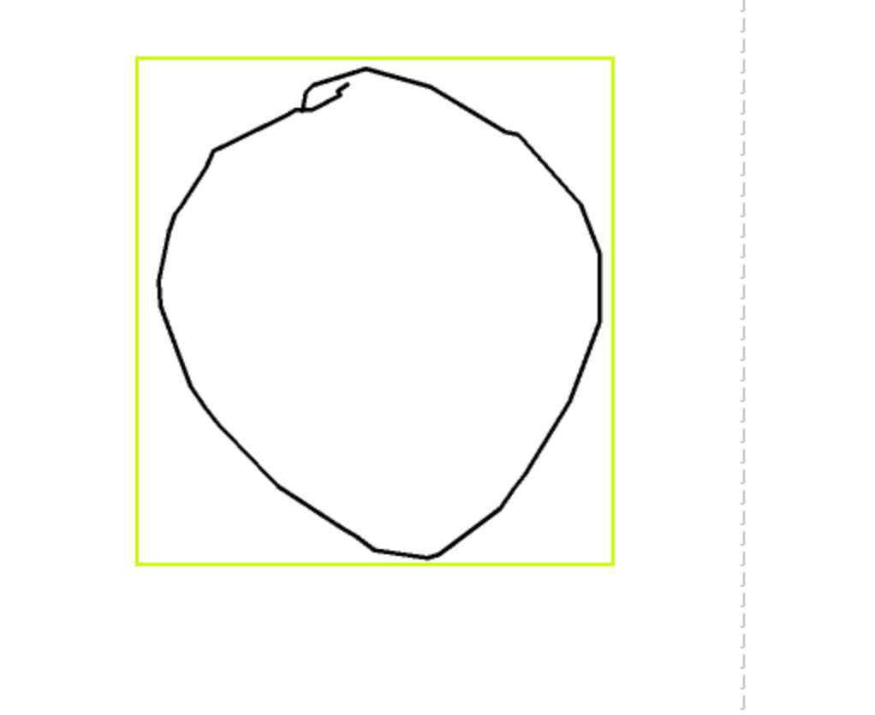
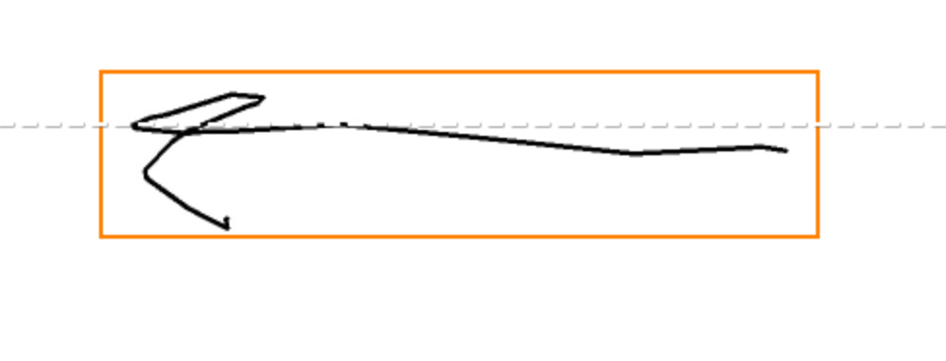
07
PROJECT · PROJECT · PROJECT · PROJ
Custom train dataset for YOLO v8
412 images after

Slide 8
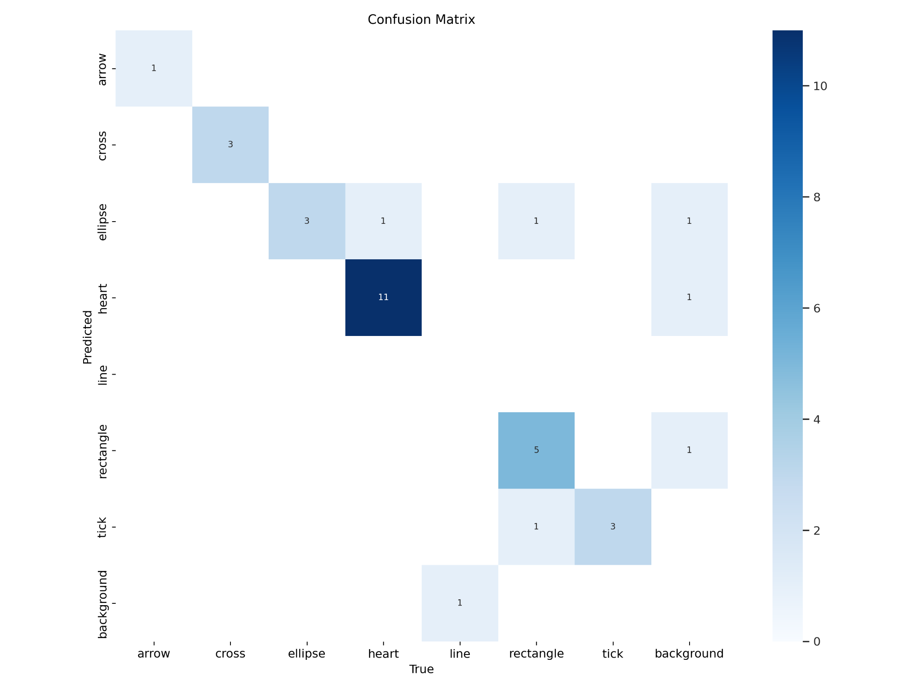
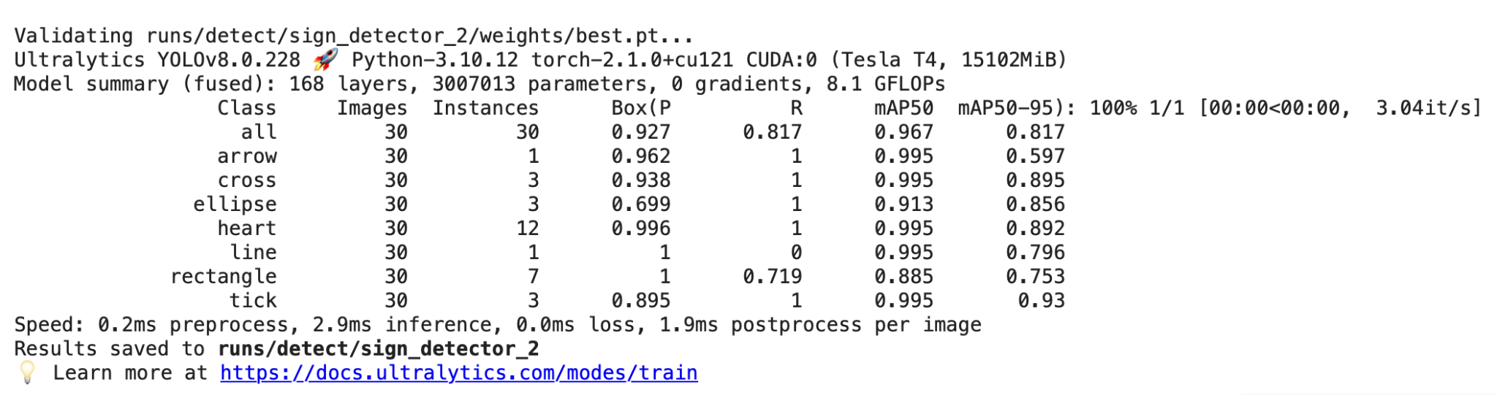
08
Metrics
PROJECT · PROJECT · PROJECT · PROJ

Slide 9
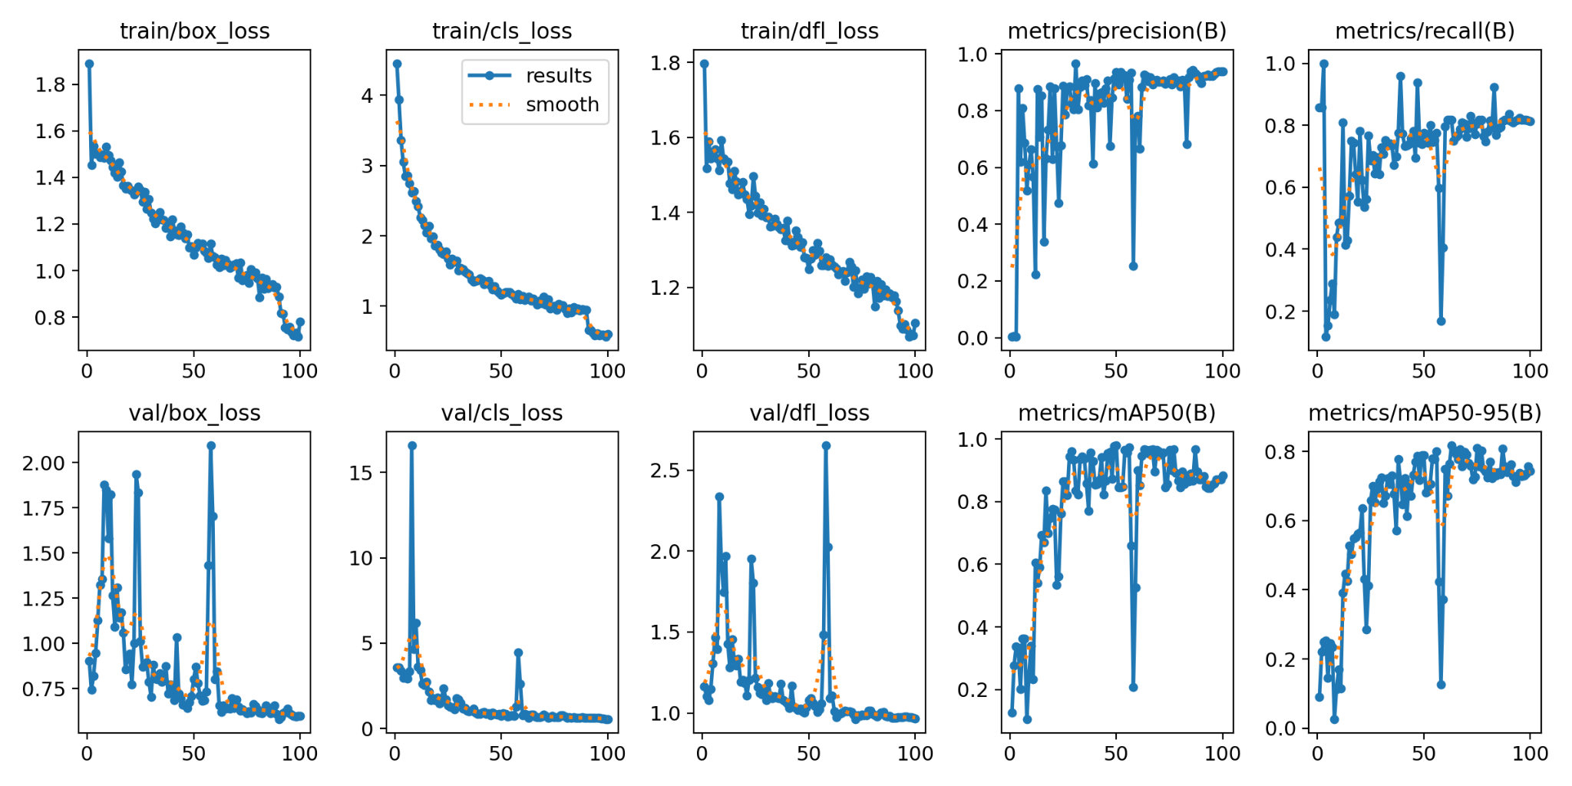
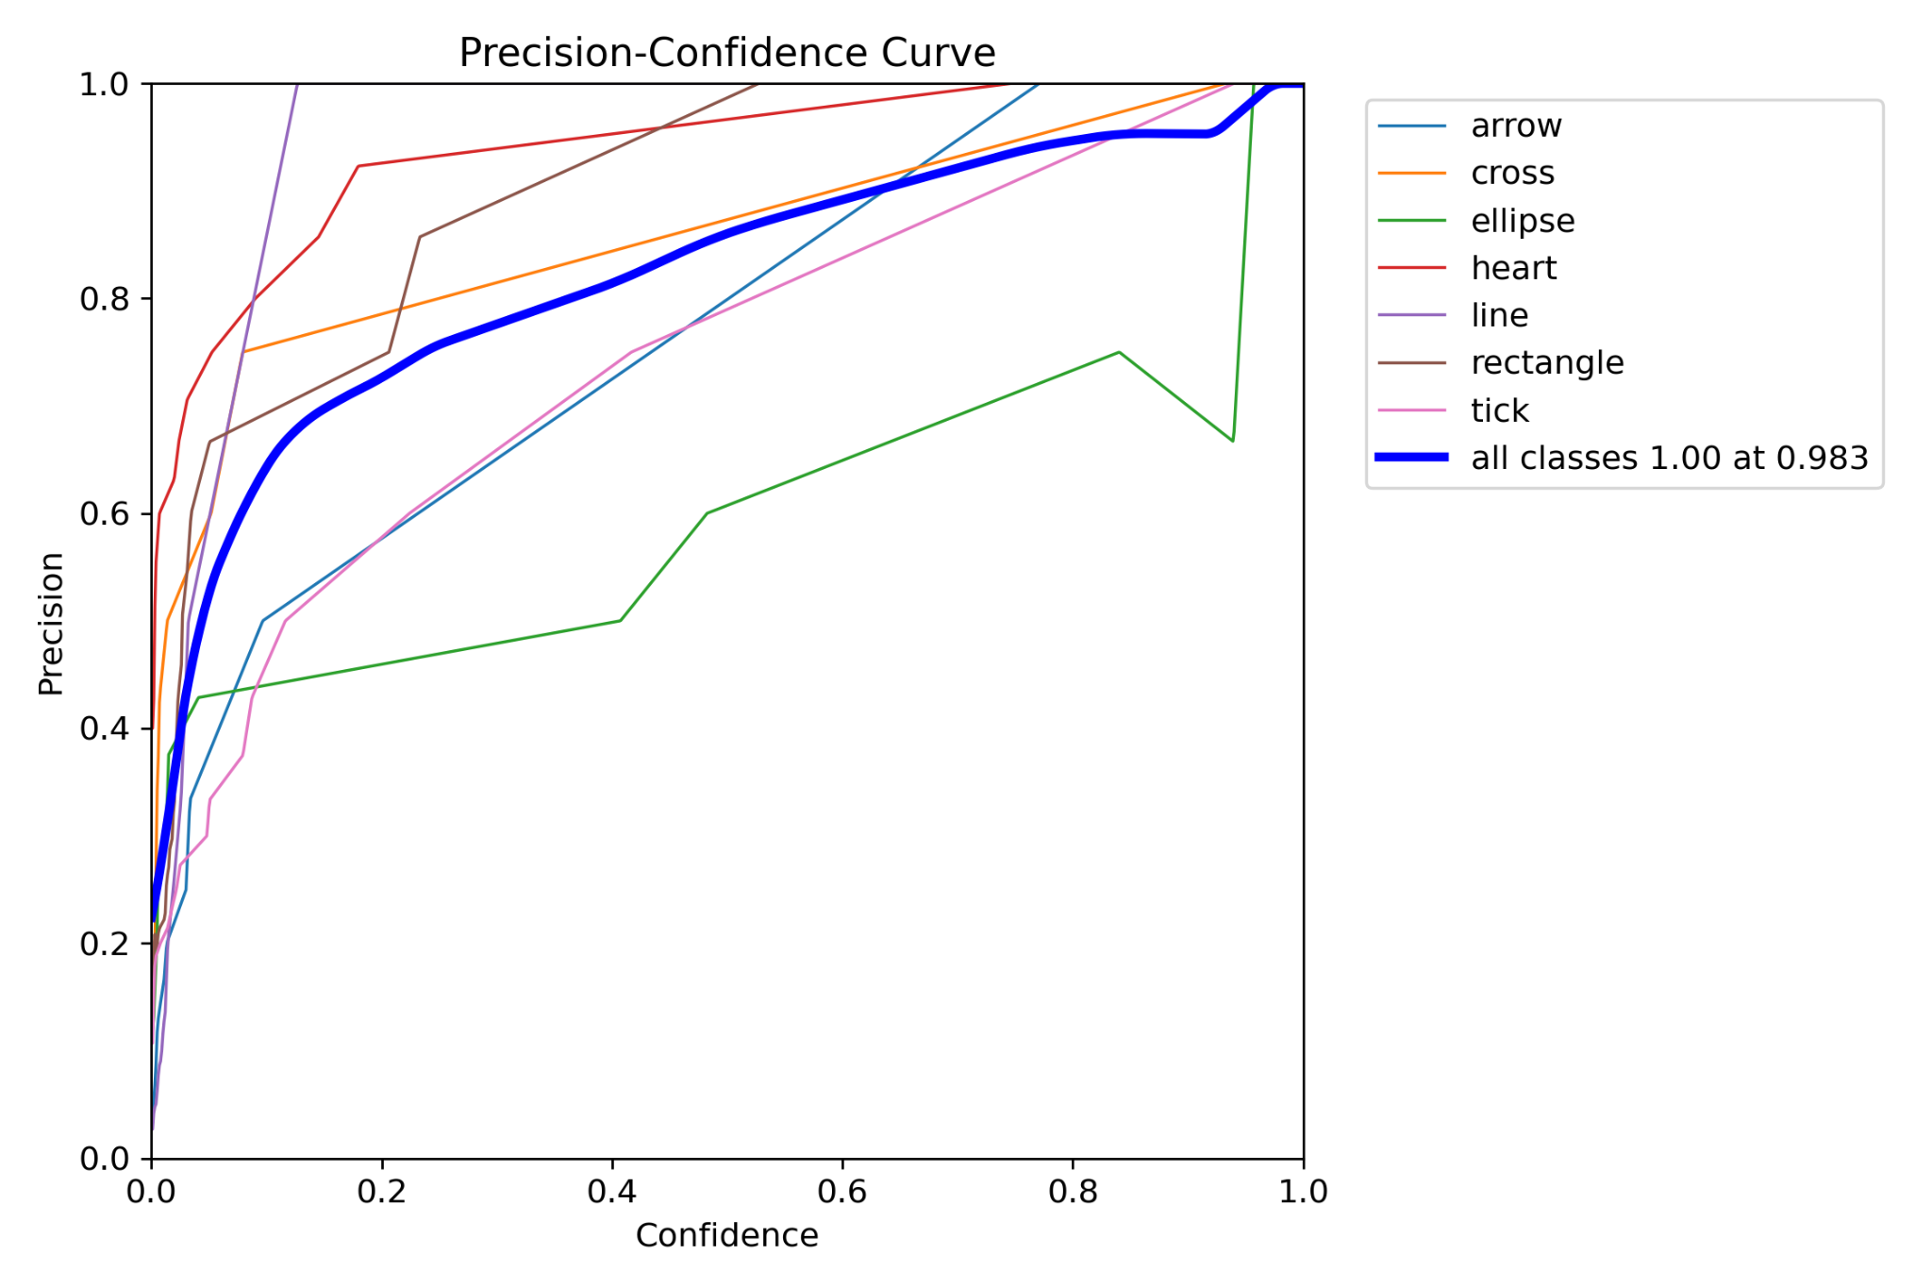
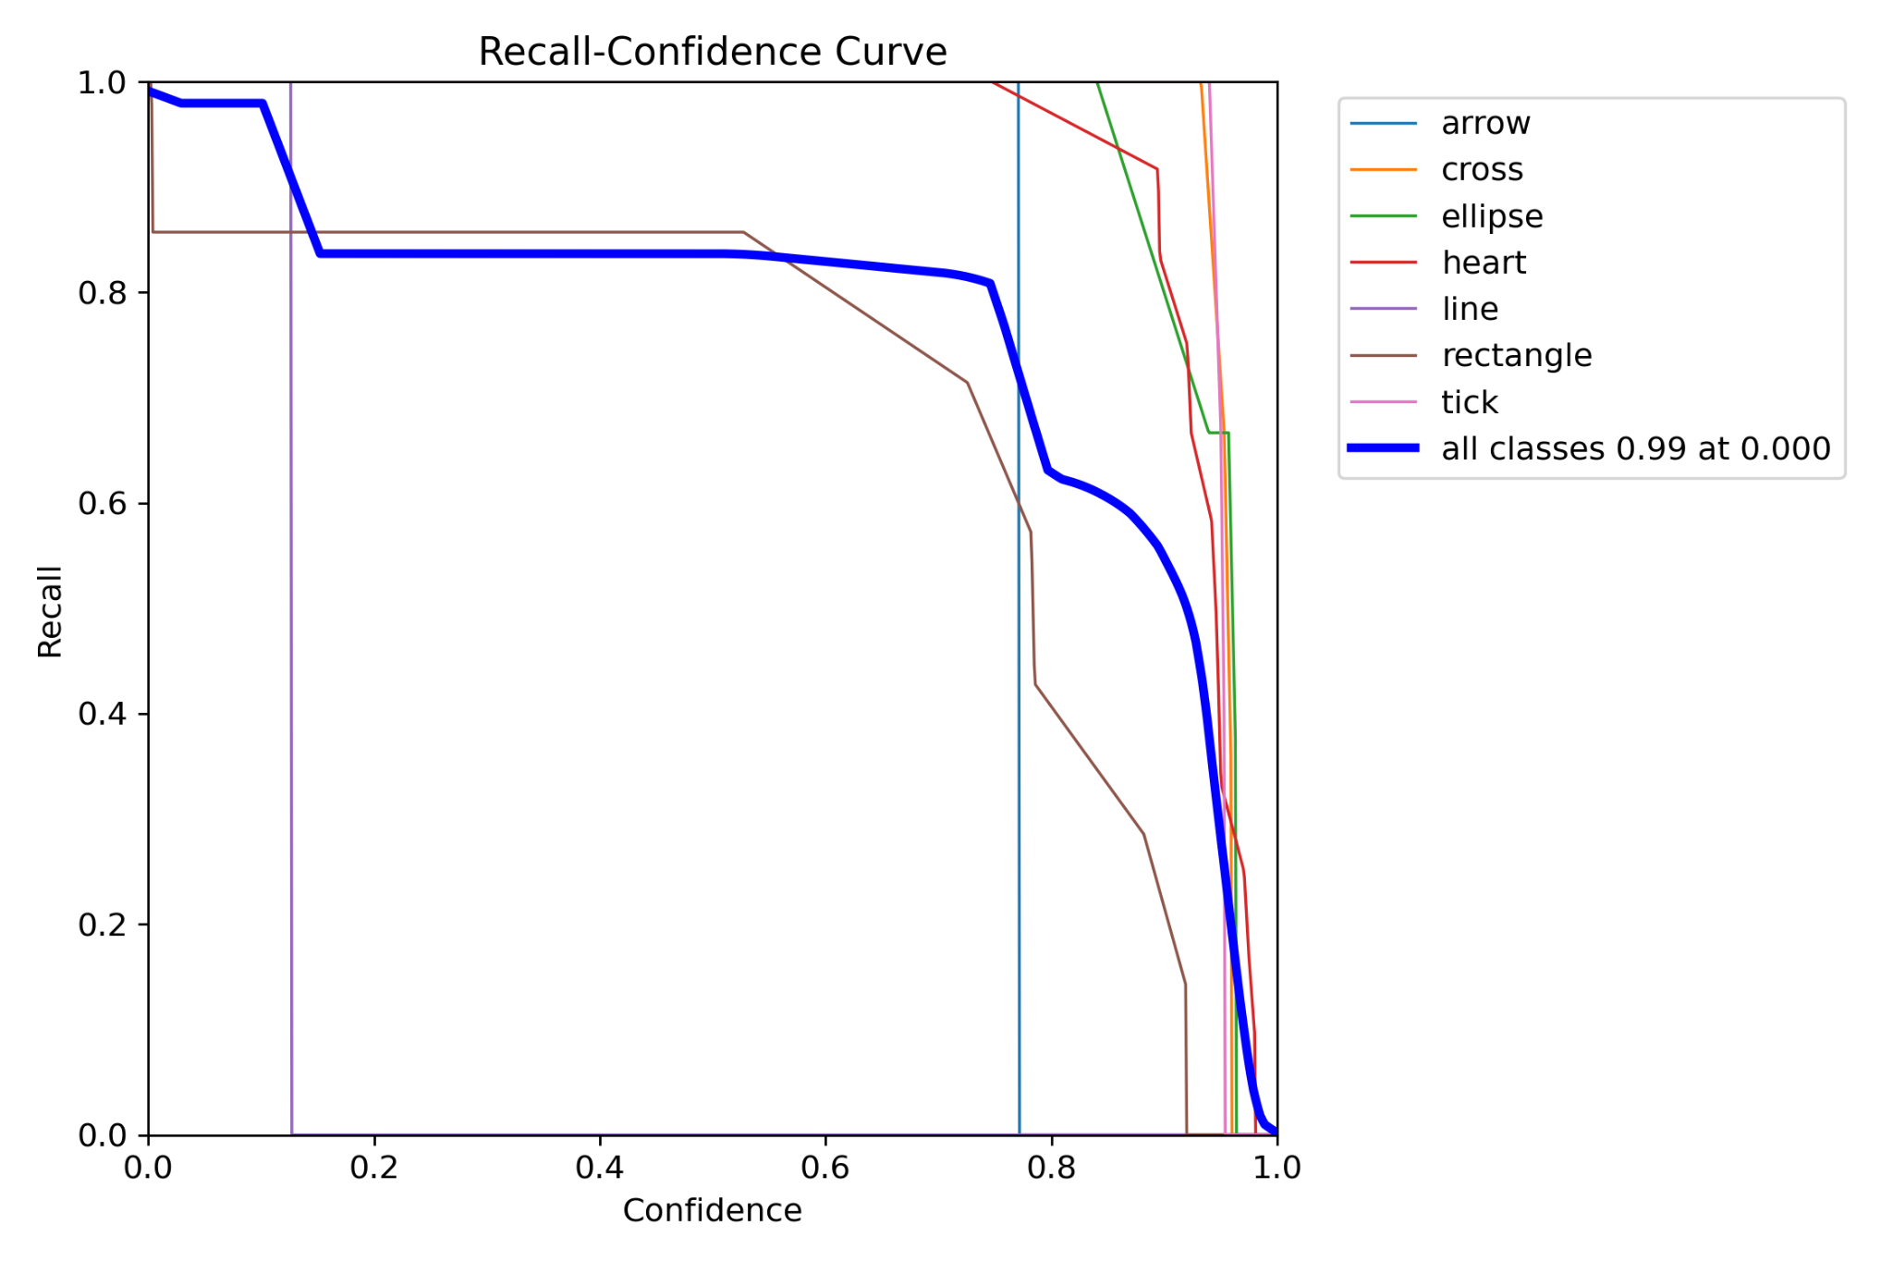
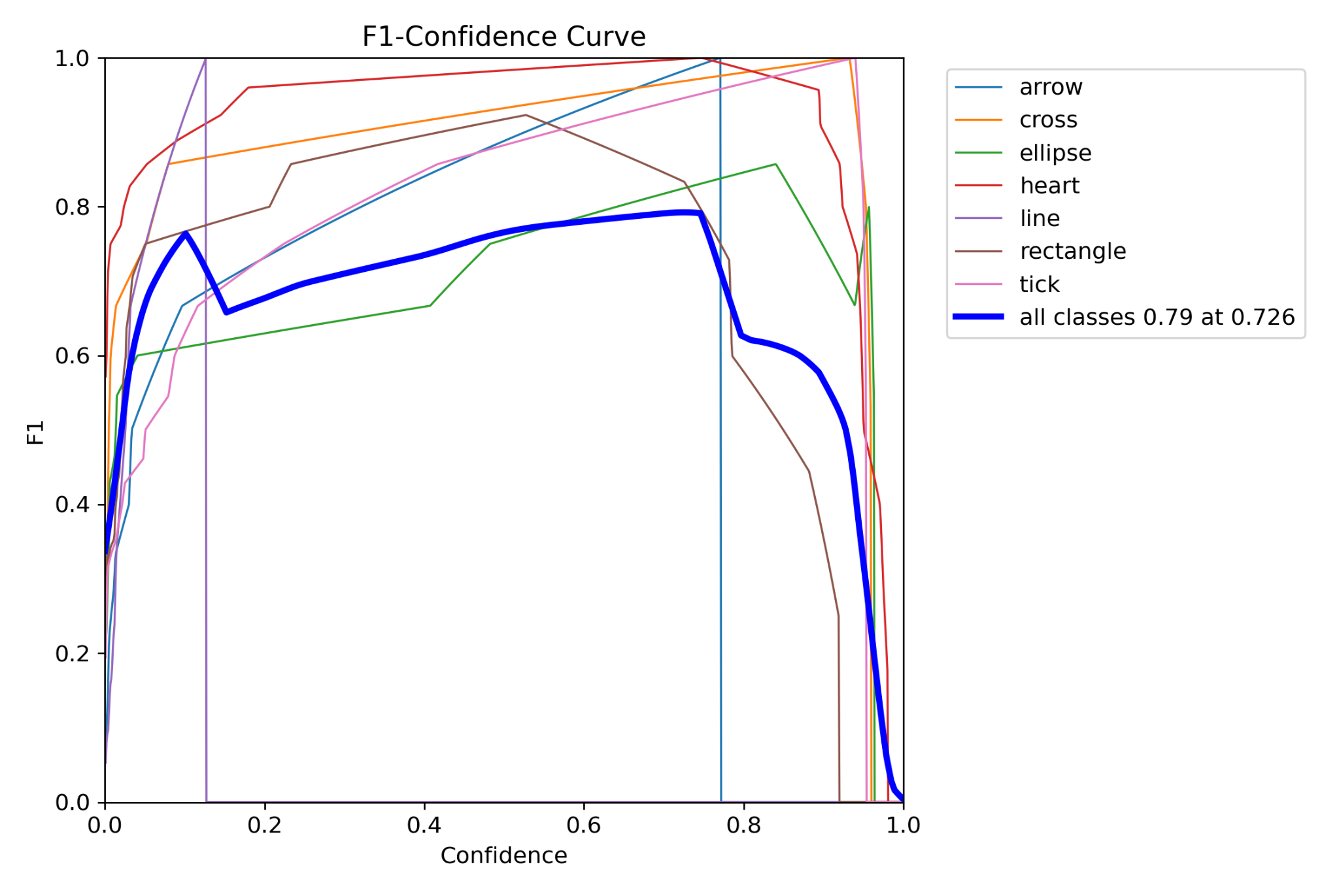
09
Metrics
PROJECT · PROJECT · PROJECT · PROJ

Slide 10
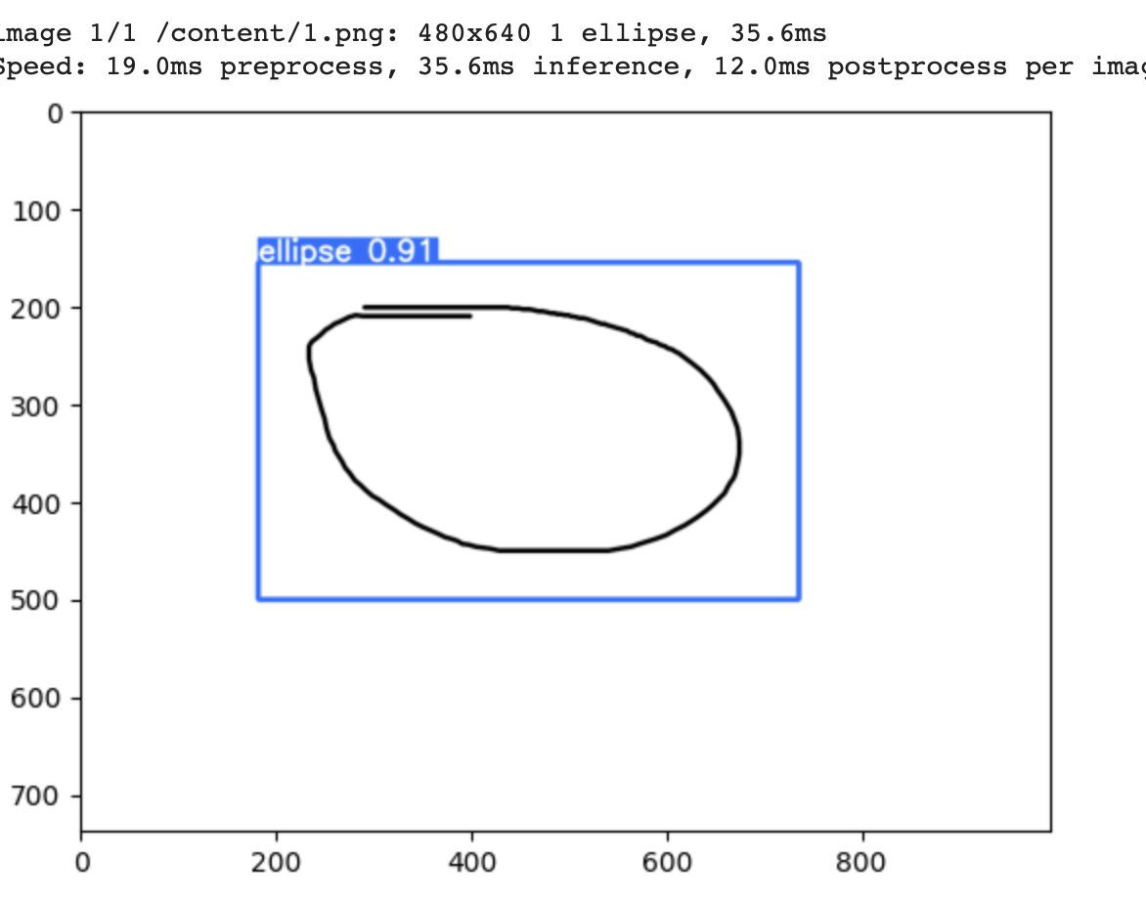
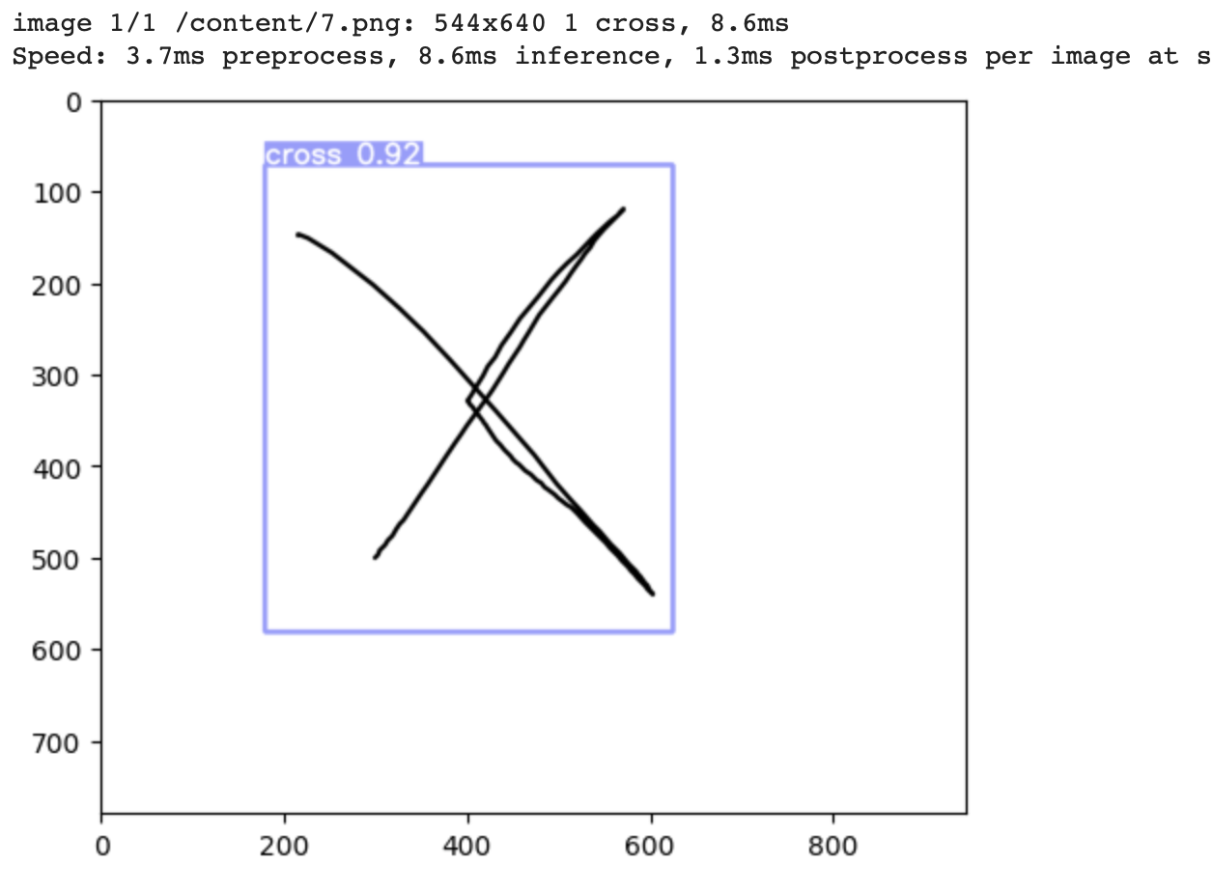
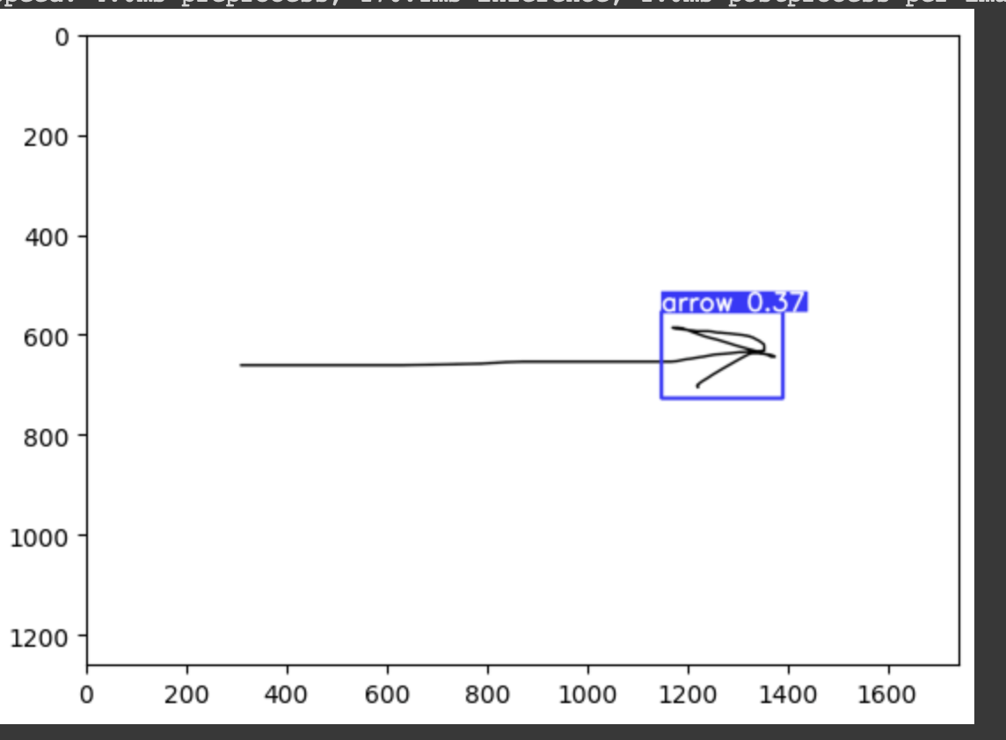
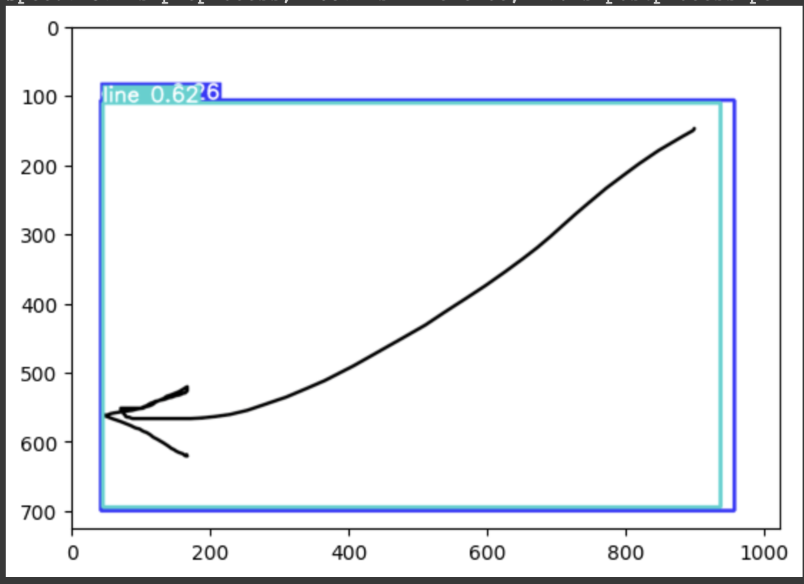
09
PROJECT · PROJECT · PROJECT · PROJ
Good/bad examples
Good
Bad

Slide 11
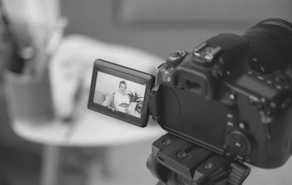
Thank you
PROJECT · PROJECT · PROJECT · PROJ
PROJECT · PROJECT · PROJECT · PROJ

